Slide 1

TO-DO LIST APPLICATION
ELİF ARSLANÇERİ

Slide 2
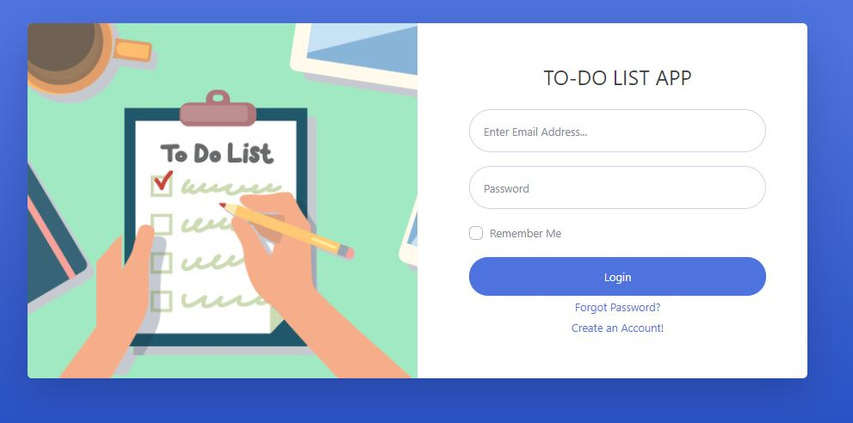
LOGIN PAGE

Slide 3
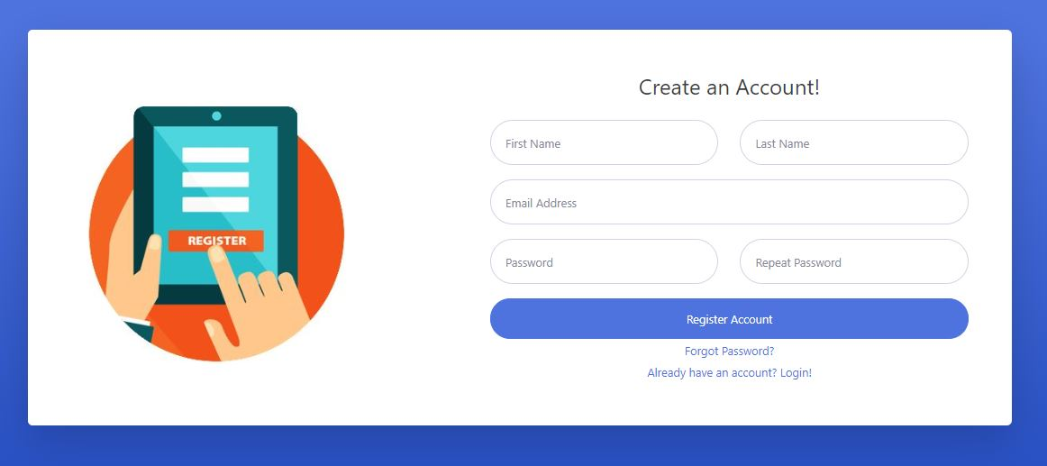
REGISTER PAGE

Slide 4
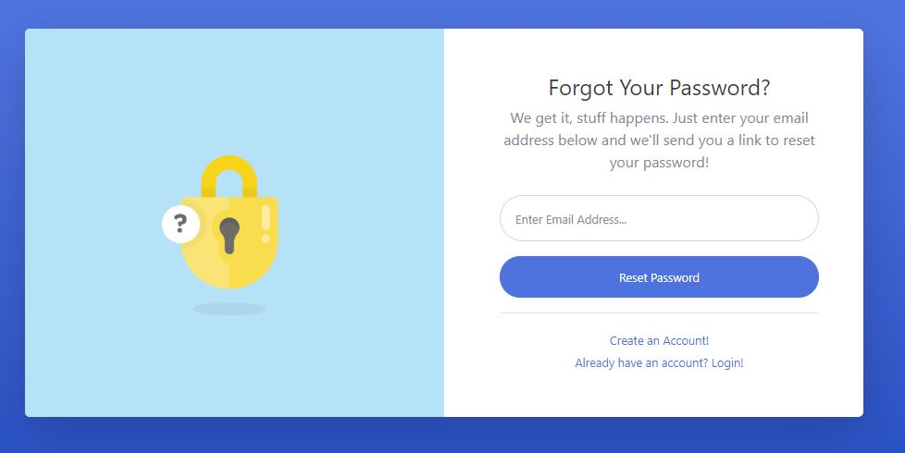
FORGOT PASSWORD

Slide 5
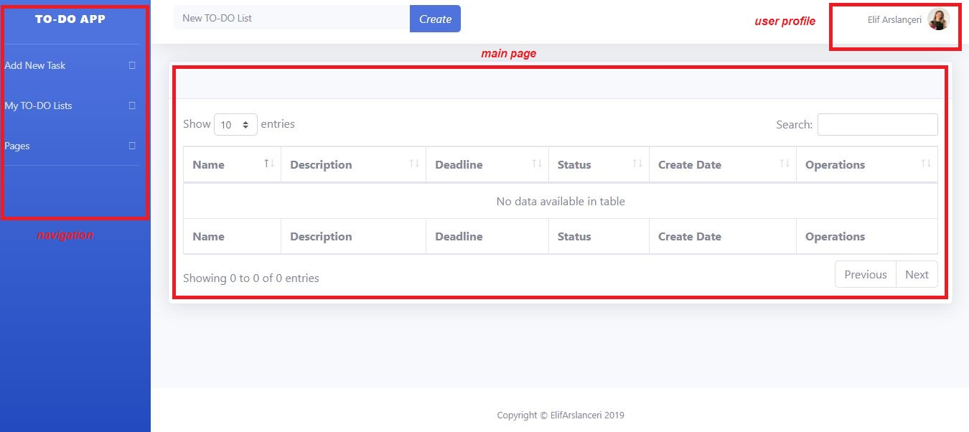
MAIN PAGE

Slide 6
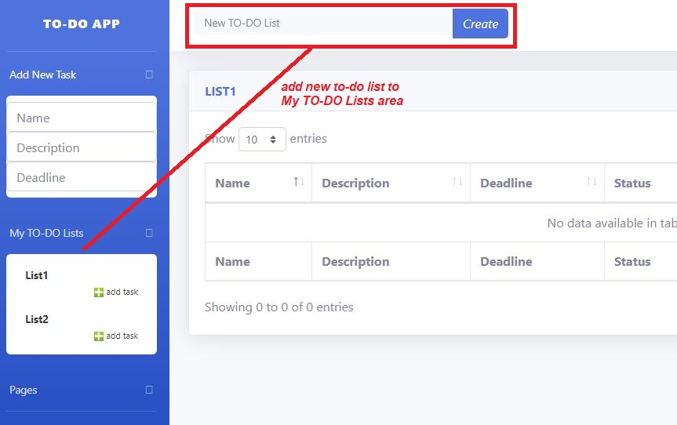
CREATE NEW TO-DO LIST

Slide 7
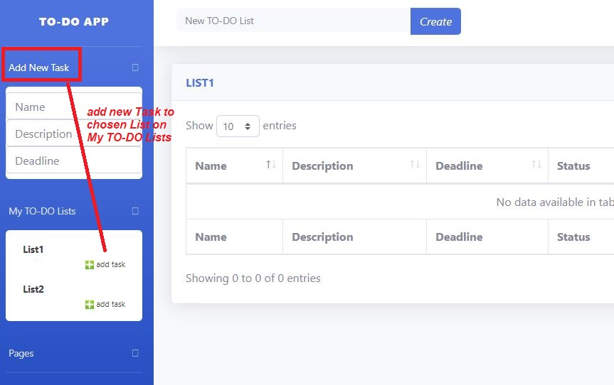
ADD NEW TASK TO LIST

Slide 8
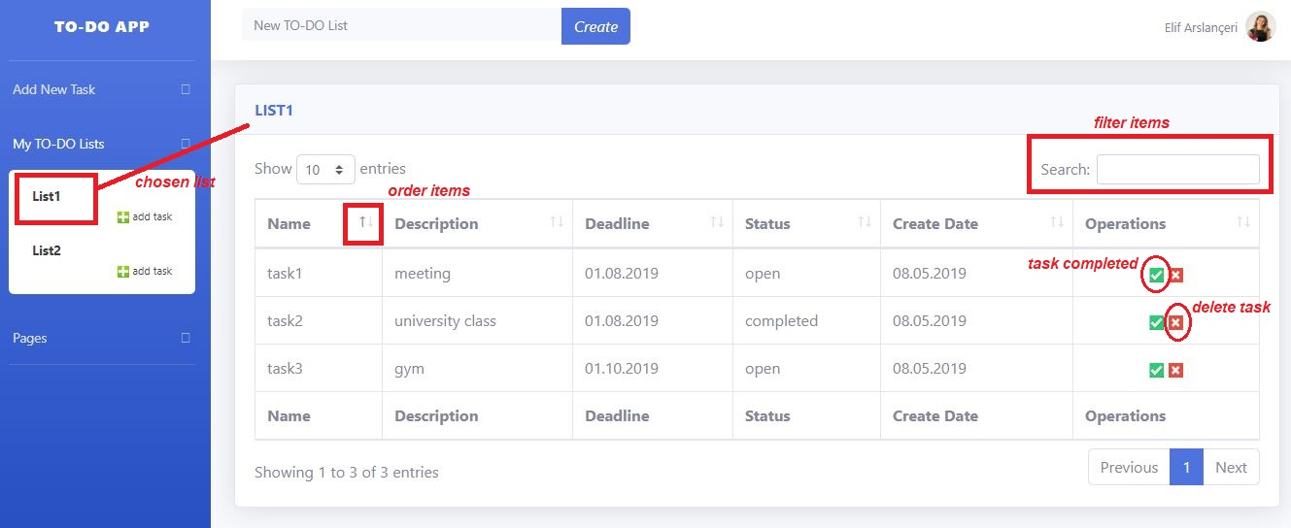
TASK TABLE

Slide 9
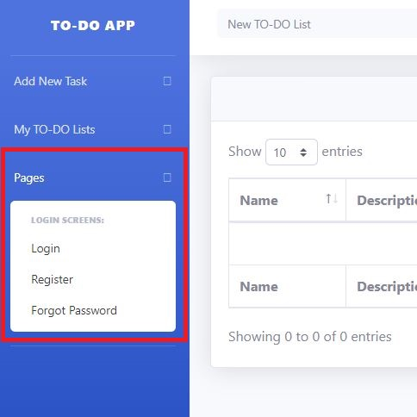
PAGES

Slide 10
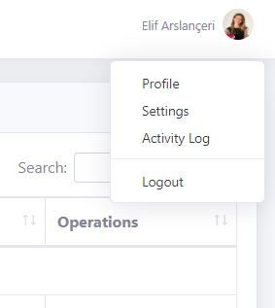
USER

